Slide 1
Method of Agreement
If in all cases where an effect occurs, there is a single factor C that is common to all those cases, then C is the cause of the effect

Slide 2
Method of Agreement
 | Oysters | Beef | Salad | Cake | Sick
John | Yes | Yes | Yes | Yes | Yes
Sally | Yes | No | No | Yes | Yes
Frank | Yes | Yes | No | No | Yes
Otto | Yes | No | Yes | No | Yes

Slide 3
Method of Agreement
 | Oysters | Beef | Salad | Cake | Sick
John | Yes | Yes | Yes | Yes | Yes
Sally | Yes | No | No | Yes | Yes
Frank | Yes | Yes | No | No | Yes
Otto | Yes | No | Yes | No | Yes

Slide 4
Method of Agreement
 | Oysters | Beef | Salad | Cake | Sick
John | Yes | Yes | Yes | Yes | Yes
Sally | Yes | No | No | Yes | Yes
Frank | Yes | Yes | No | No | Yes
Otto | Yes | No | Yes | No | Yes

Slide 5
Method of Agreement
 | Oysters | Beef | Salad | Cake | Sick
John | Yes | Yes | Yes | Yes | Yes
Sally | Yes | No | No | Yes | Yes
Frank | Yes | Yes | No | No | Yes
Otto | Yes | No | Yes | No | Yes

Slide 6
Method of Agreement
If in all cases where an effect occurs, there is a single factor C that is common to all those cases, then C is the cause of the effect
MODEL THIS EXAMPLE IN PROTEGE

Slide 7
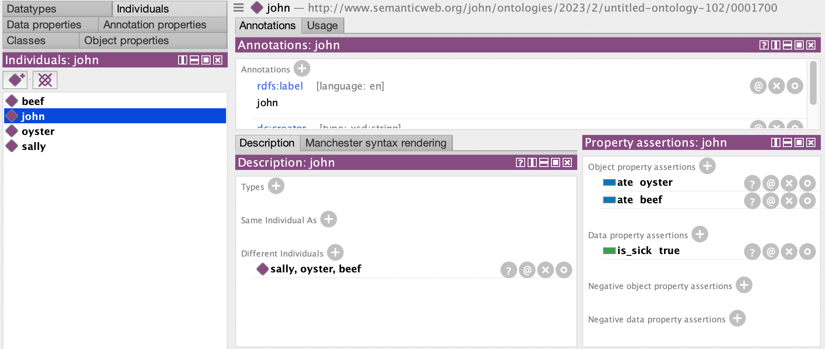

Slide 8
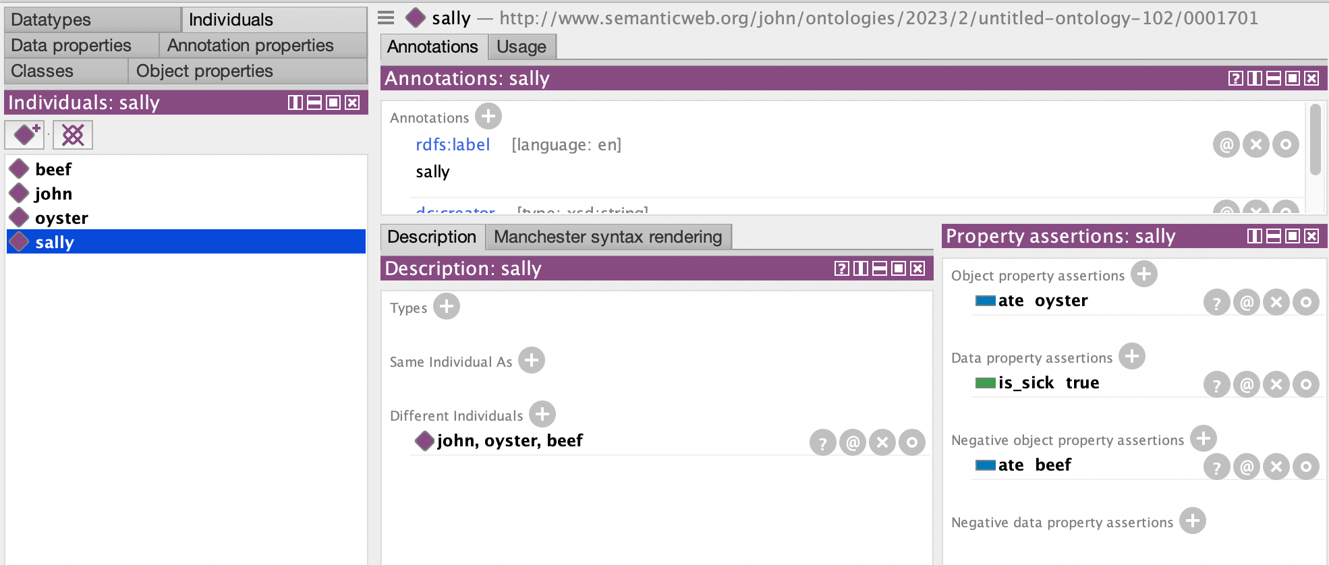

Slide 9
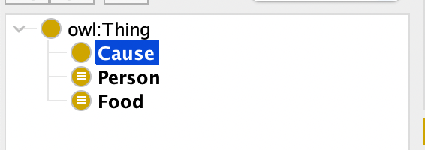
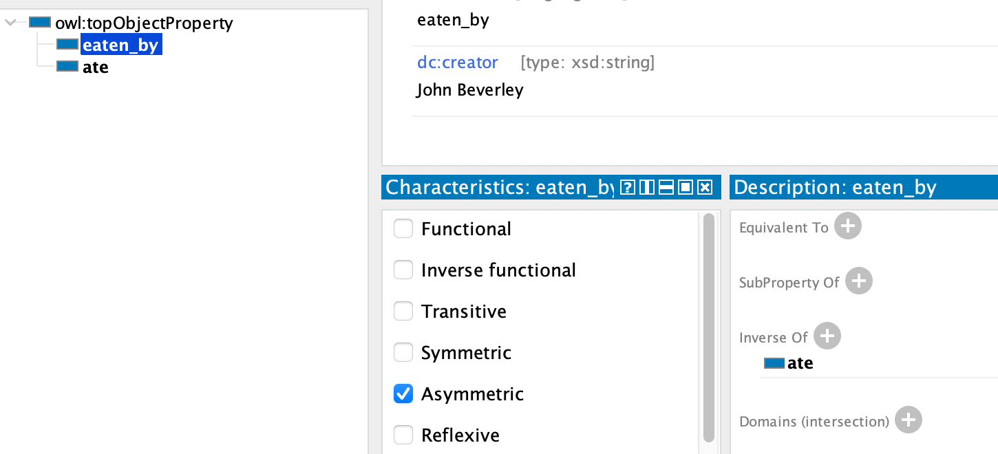
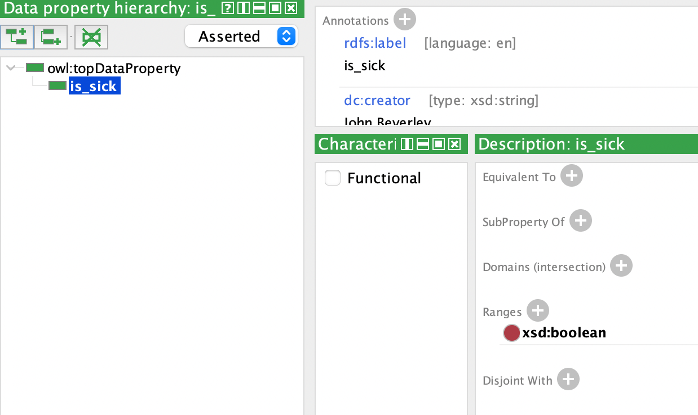

Slide 10
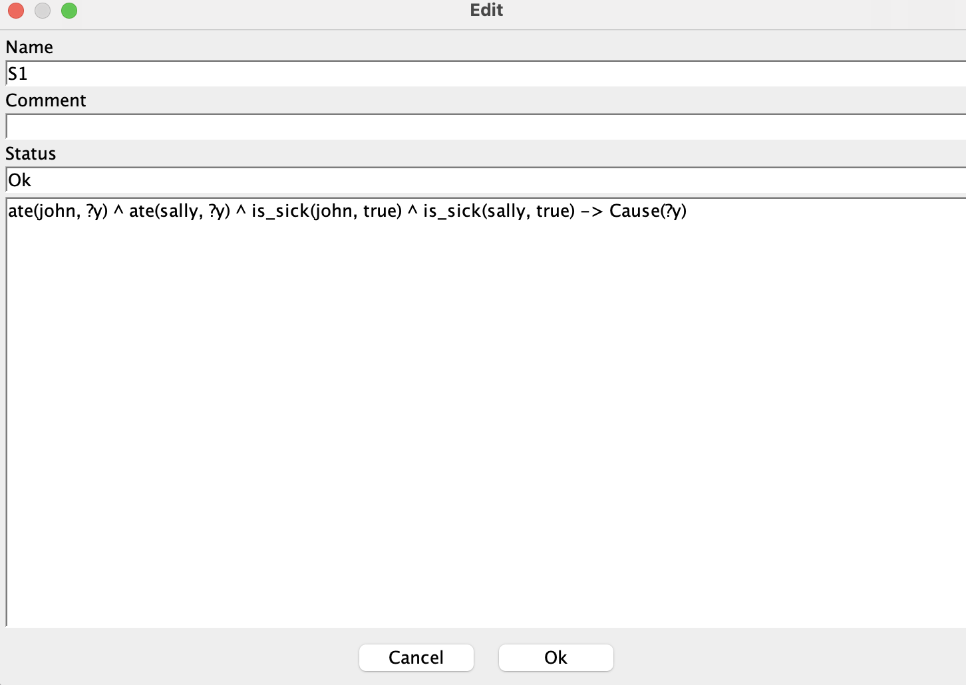
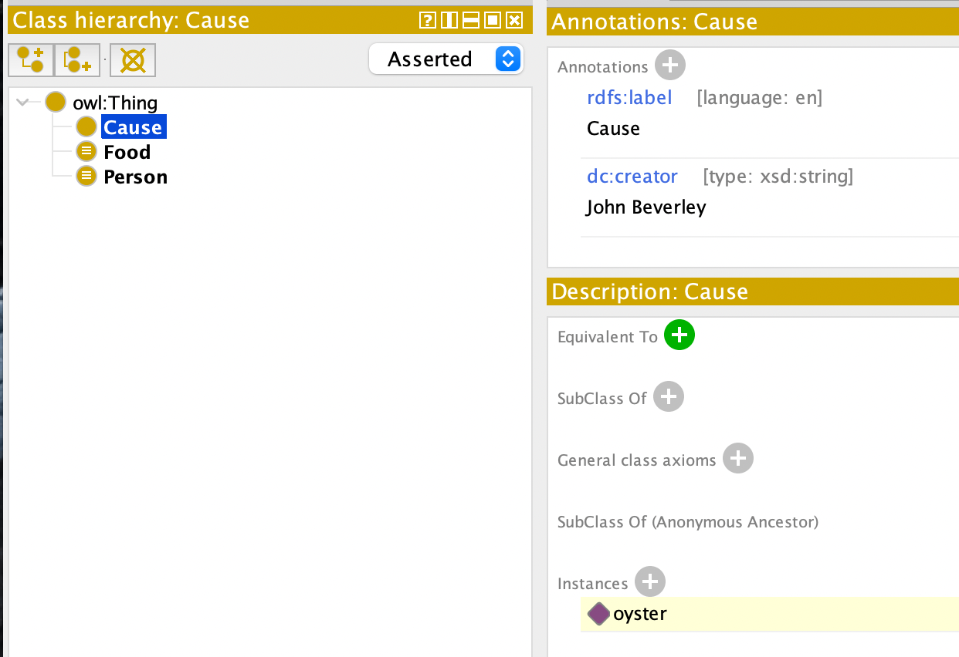

Slide 14
Method of Difference
If you have one situation that leads to an effect, and another which does not, and the only difference is the presence of a single factor C in the first situation, we can infer C causes the effect

Slide 15
Method of Difference
 | Oysters | Beef | Salad | Cake | Sick
John | Yes | Yes | Yes | Yes | Yes
Sally | Yes | Yes | Yes | Yes | Yes
Frank | Yes | Yes | Yes | Yes | Yes
Otto | Yes | Yes | No | Yes | No

Slide 16
Method of Difference
 | Oysters | Beef | Salad | Cake | Sick
John | Yes | Yes | Yes | Yes | Yes
Sally | Yes | Yes | Yes | Yes | Yes
Frank | Yes | Yes | Yes | Yes | Yes
Otto | Yes | Yes | No | Yes | No

Slide 17
Method of Difference
 | Oysters | Beef | Salad | Cake | Sick
John | Yes | Yes | Yes | Yes | Yes
Sally | Yes | Yes | Yes | Yes | Yes
Frank | Yes | Yes | Yes | Yes | Yes
Otto | Yes | Yes | No | Yes | No

Slide 18
Method of Difference
If you have one situation that leads to an effect, and another which does not, and the only difference is the presence of a single factor C in the first situation, we can infer C causes the effect
MODEL THIS EXAMPLE IN PROTEGE

Slide 19
Agreement and Difference
If in all cases where an effect occurs, there is a single factor C that is common to all those cases, then C is the cause of the effect
If you have one situation that leads to an effect, and another which does not, and the only difference is the presence of a single factor C in the first situation, we can infer C causes the effect

Slide 20
Agreement and Difference
 | Oysters | Beef | Salad | Cake | Sick
John | Yes | Yes | Yes | Yes | Yes
Sally | Yes | Yes | No | Yes | Yes
Frank | Yes | Yes | Yes | No | Yes
Otto | Yes | No | No | Yes | No

Slide 21
Agreement and Difference
 | Oysters | Beef | Salad | Cake | Sick
John | Yes | Yes | Yes | Yes | Yes
Sally | Yes | Yes | No | Yes | Yes
Frank | Yes | Yes | Yes | No | Yes
Otto | Yes | No | No | Yes | No

Slide 22
Agreement and Difference
 | Oysters | Beef | Salad | Cake | Sick
John | Yes | Yes | Yes | Yes | Yes
Sally | Yes | Yes | No | Yes | Yes
Frank | Yes | Yes | Yes | No | Yes
Otto | Yes | No | No | Yes | No

Slide 23
Agreement and Difference
 | Oysters | Beef | Salad | Cake | Sick
John | Yes | Yes | Yes | Yes | Yes
Sally | Yes | Yes | No | Yes | Yes
Frank | Yes | Yes | Yes | No | Yes
Otto | Yes | No | No | Yes | No

Slide 24
Agreement and Difference
 | Oysters | Beef | Salad | Cake | Sick
John | Yes | Yes | Yes | Yes | Yes
Sally | Yes | Yes | No | Yes | Yes
Frank | Yes | Yes | Yes | No | Yes
Otto | Yes | No | No | Yes | No

Slide 25
Agreement and Difference
 | Oysters | Beef | Salad | Cake | Sick
John | Yes | Yes | Yes | Yes | Yes
Sally | Yes | Yes | No | Yes | Yes
Frank | Yes | Yes | Yes | No | Yes
Otto | Yes | No | No | Yes | No

Slide 26
Agreement and Difference
 | Oysters | Beef | Salad | Cake | Sick
John | Yes | Yes | Yes | Yes | Yes
Sally | Yes | Yes | No | Yes | Yes
Frank | Yes | Yes | Yes | No | Yes
Otto | Yes | No | No | Yes | No

Slide 27
Agreement and Difference
If in all cases where an effect occurs, there is a single factor C that is common to all those cases, then C is the cause of the effect
If you have one situation that leads to an effect, and another which does not, and the only difference is the presence of a single factor C in the first situation, we can infer C causes the effect
MODEL THIS EXAMPLE IN PROTEGE

Slide 28
Method of Concomitant Variation
If across a range of situations that lead to a certain effect, we find a certain property of the effect varying with variation in a factor C common to those situations, then we can infer C is the cause

Slide 29
Method of Concomitant Variation
 | Oysters | Beef | Salad | Cake | Sick
John | Yes | Yes | Yes | Yes | Yes
Sally | Yes | Yes | Yes | Yes | Yes
Frank | Yes | Yes | Yes | Yes | Yes
Otto | Yes | Yes | Yes | Yes | Yes

Slide 30
Method of Concomitant Variation
 | Oysters | Beef | Salad | Cake | Sick
John | Yes | Yes | Yes | Yes | Little
Sally | Yes | Yes | Yes | Yes | Little
Frank | Yes | Yes | Yes | Yes | Very
Otto | Yes | Yes | Yes | Yes | Critical

Slide 31
Method of Concomitant Variation
 | Oysters | Beef | Salad | Cake | Sick
John | Yes | Yes | Yes | Yes | Little
Sally | Yes | Yes | Yes | Yes | Little
Frank | Yes | Yes | Yes | Yes | Very
Otto | Yes | Yes | Yes | Yes | Critical

Slide 32
Method of Concomitant Variation
 | Oysters | Beef | Salad | Cake | Sick
John | Yes | Yes | Yes | Same | Little
Sally | Yes | Yes | Yes | Same | Little
Frank | Yes | Yes | Yes | Same | Very
Otto | Yes | Yes | Yes | Same | Critical

Slide 33
Method of Concomitant Variation
 | Oysters | Beef | Salad | Cake | Sick
John | Yes | Yes | Yes | Same | Little
Sally | Yes | Yes | Yes | Same | Little
Frank | Yes | Yes | Yes | Same | Very
Otto | Yes | Yes | Yes | Same | Critical

Slide 34
Method of Concomitant Variation
 | Oysters | Beef | Salad | Cake | Sick
John | Yes | Same | Same | Same | Little
Sally | Yes | Same | Same | Same | Little
Frank | Yes | Same | Same | Same | Very
Otto | Yes | Same | Same | Same | Critical

Slide 35
Method of Concomitant Variation
 | Oysters | Beef | Salad | Cake | Sick
John | Yes | Same | Same | Same | Little
Sally | Yes | Same | Same | Same | Little
Frank | Yes | Same | Same | Same | Very
Otto | Yes | Same | Same | Same | Critical

Slide 36

Method of Concomitant Variation
 | Oysters | Beef | Salad | Cake | Sick
John | Yes | Same | Same | Same | Little
Sally | Yes | Same | Same | Same | Little
Frank | Yes | Same | Same | Same | Very
Otto | Yes | Same | Same | Same | Critical

Slide 37
Method of Concomitant Variation
 | Oysters | Beef | Salad | Cake | Sick
John | 1 | Same | Same | Same | Little
Sally | 1 | Same | Same | Same | Little
Frank | 4 | Same | Same | Same | Very
Otto | 12 | Same | Same | Same | Critical

Slide 38
Method of Concomitant Variation
 | Oysters | Beef | Salad | Cake | Sick
John | 1 | Same | Same | Same | Little
Sally | 1 | Same | Same | Same | Little
Frank | 4 | Same | Same | Same | Very
Otto | 12 | Same | Same | Same | Critical

Slide 39
Method of Concomitant Variation
 | Oysters | Beef | Salad | Cake | Sick
John | 1 | Same | Same | Same | Little
Sally | 1 | Same | Same | Same | Little
Frank | 4 | Same | Same | Same | Very
Otto | 12 | Same | Same | Same | Critical

Slide 40
Method of Concomitant Variation
If across a range of situations that lead to a certain effect, we find a certain property of the effect varying with variation in a factor C common to those situations, then we can infer C is the cause
MODEL THIS EXAMPLE IN PROTEGE

